Slide 1
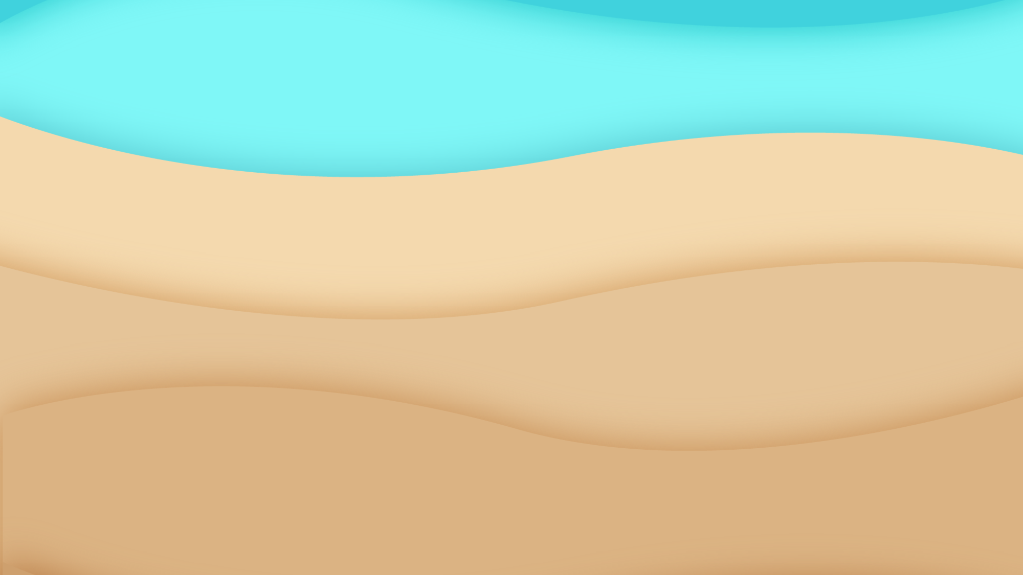
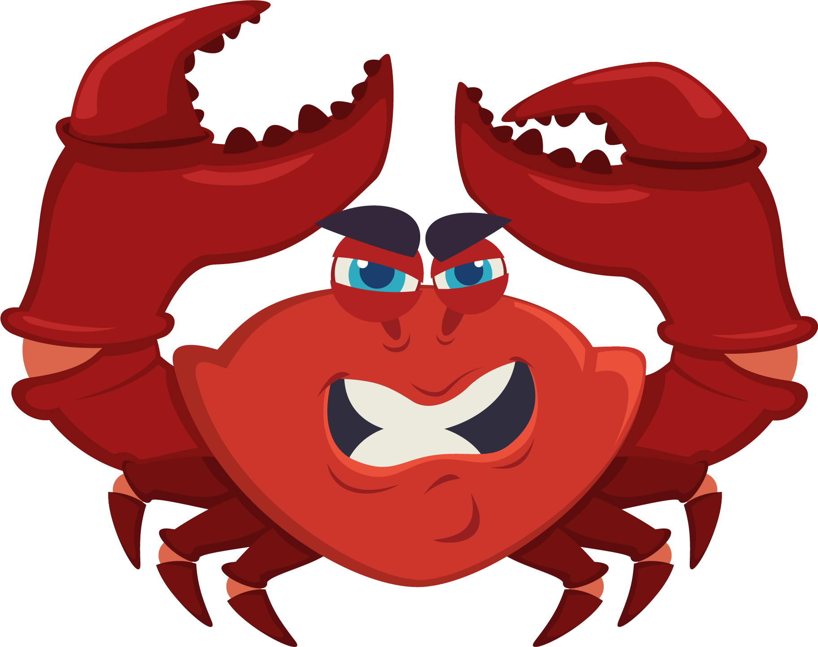
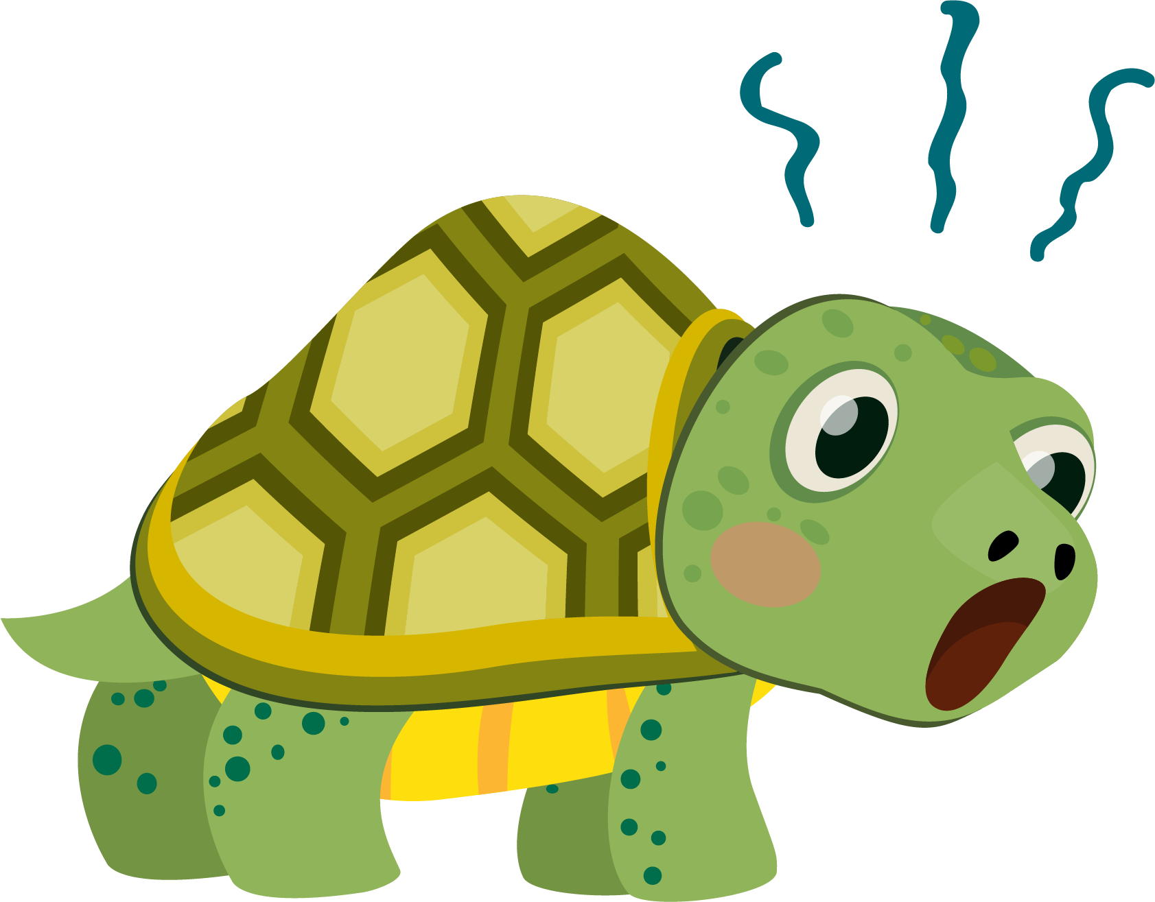
Lesson 6:
Turtle Crossing

Slide 2
Slide

Slide 3
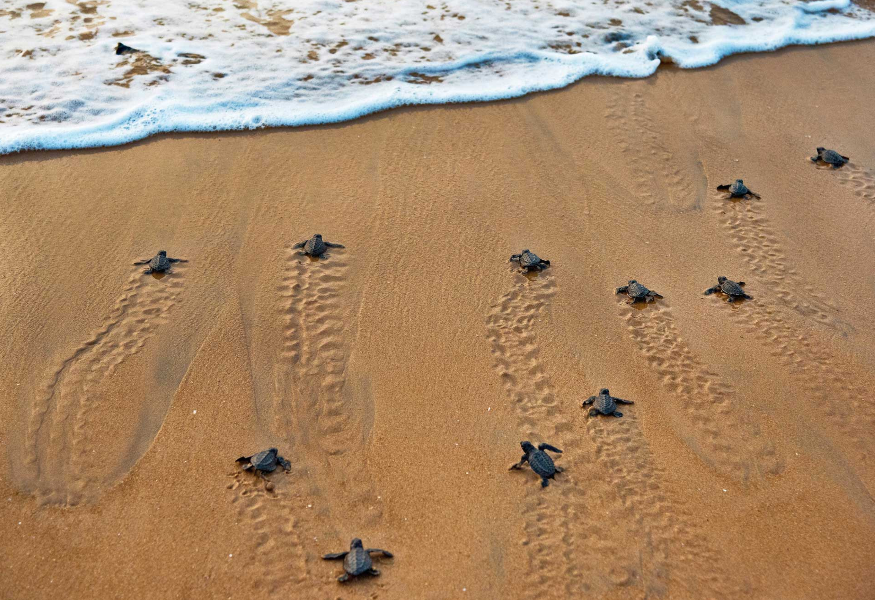
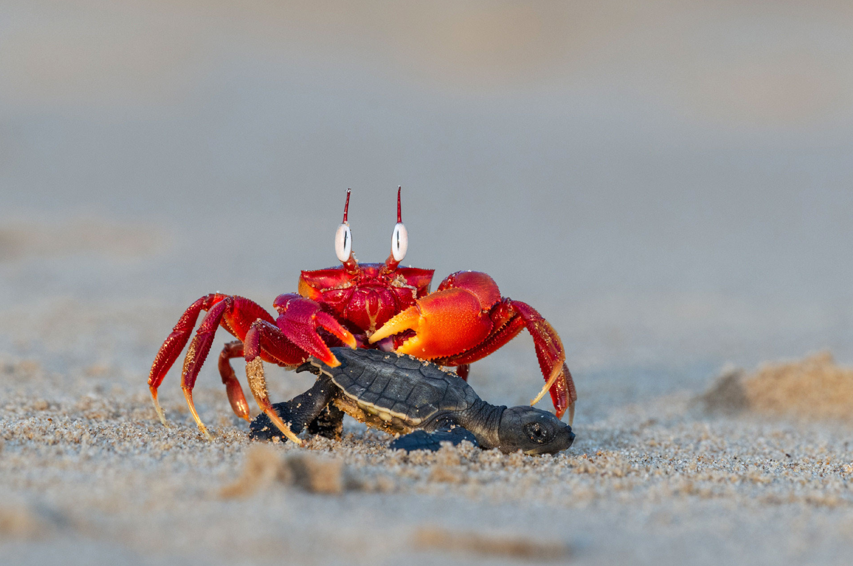
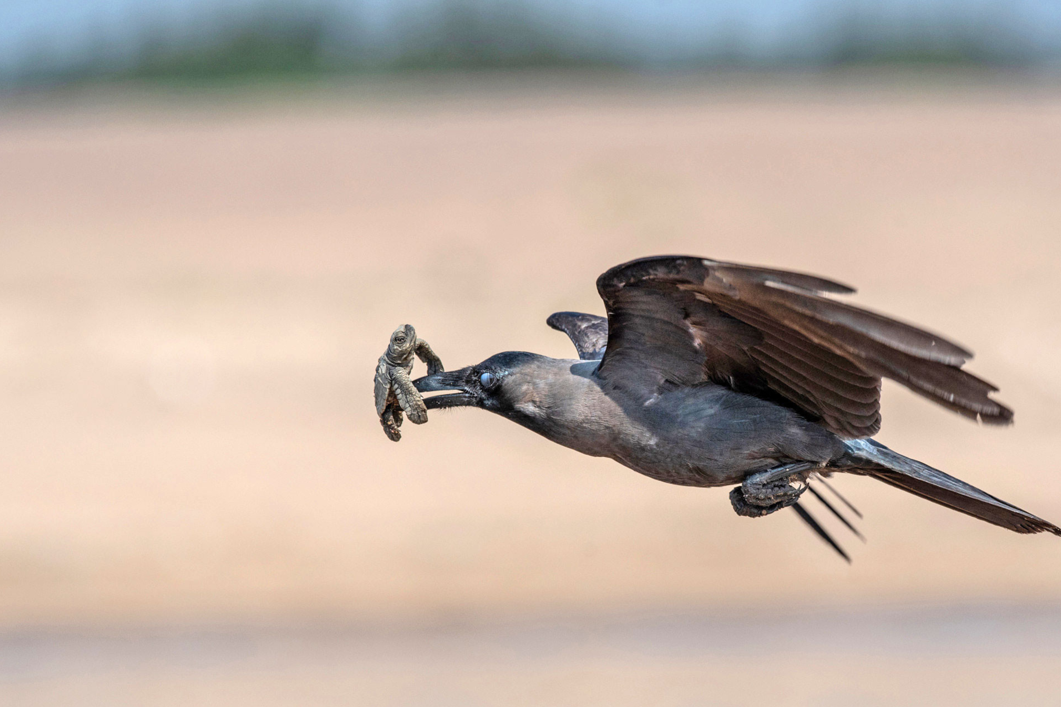
Dangerous Journey…

Slide 4
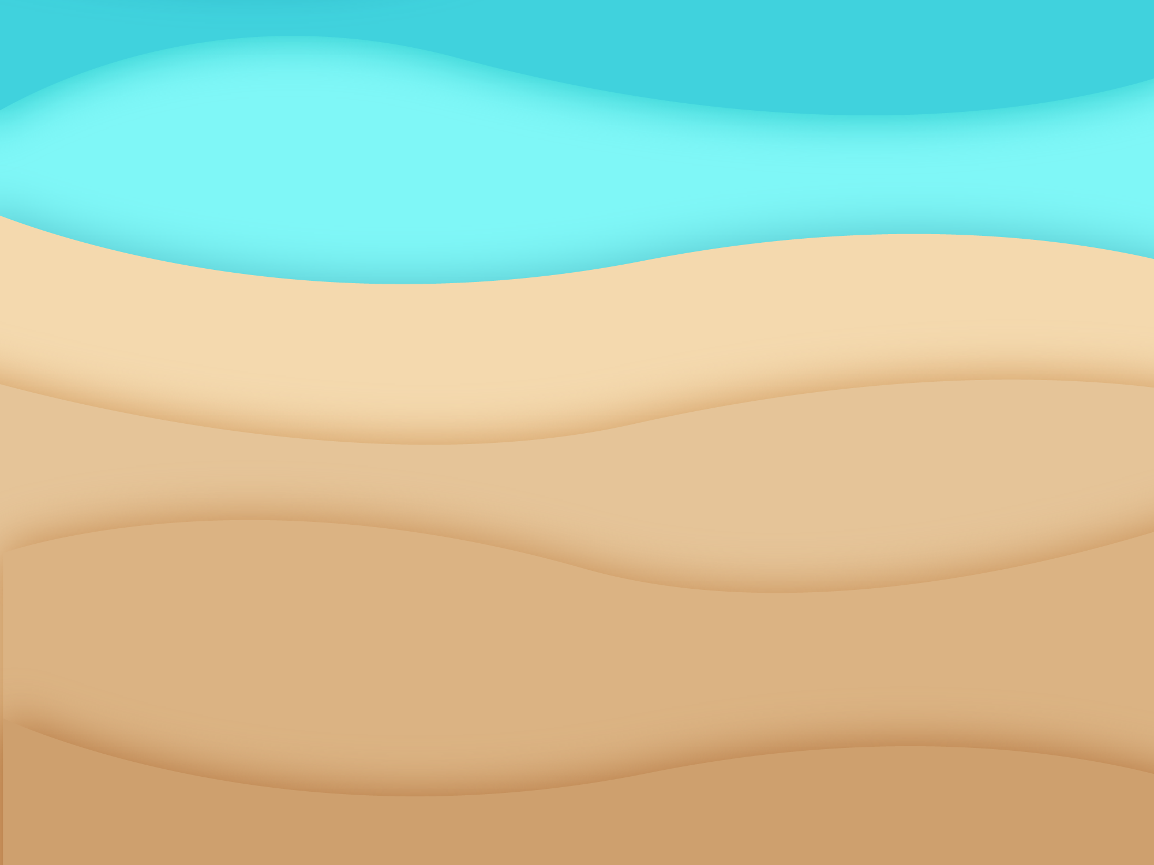
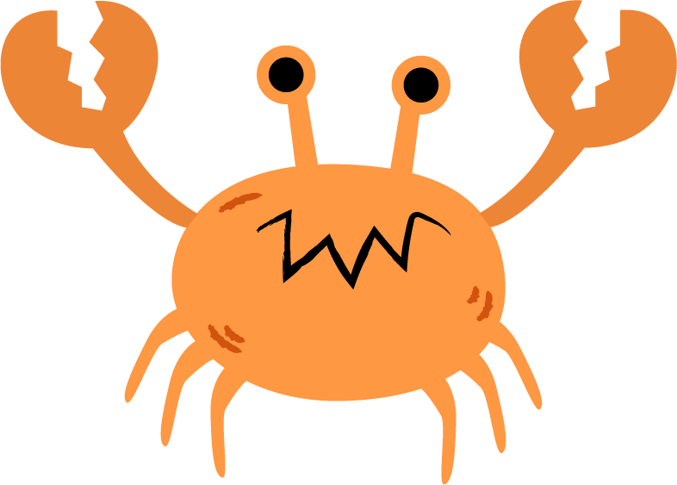
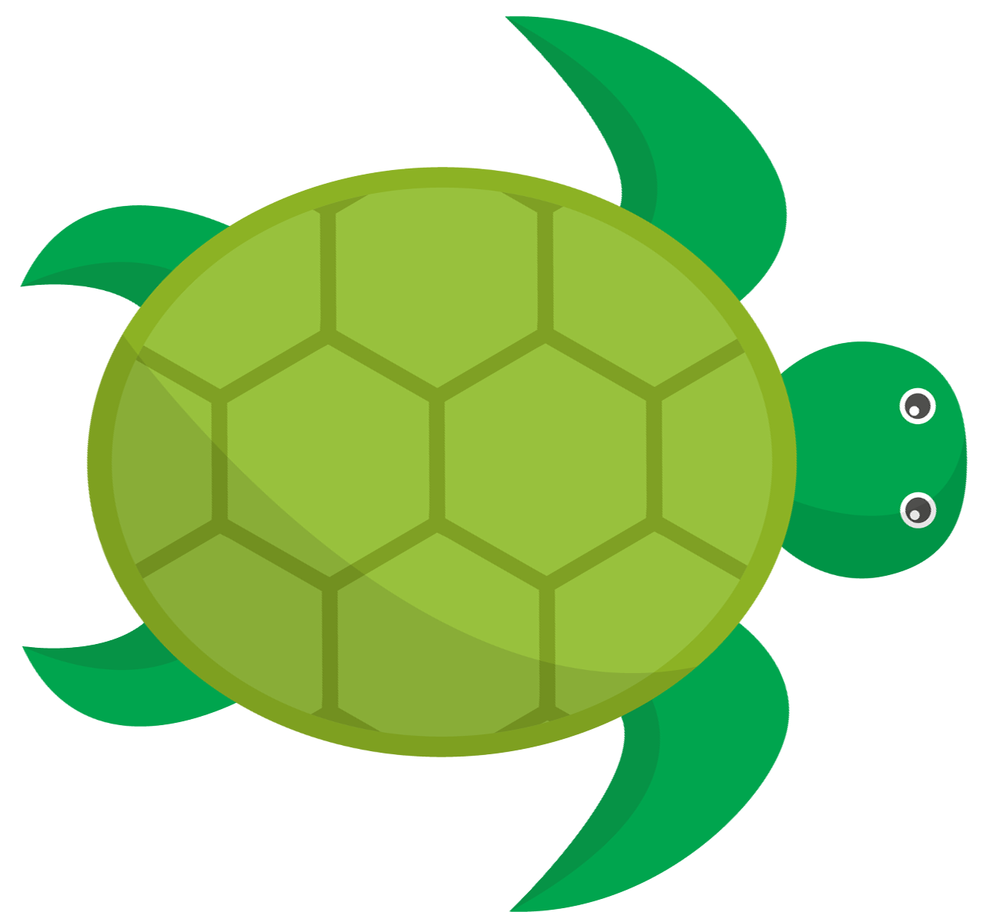
Turtle Crossing

Slide 5

Pick a Local Backdrop
Scratch for Newbies
Level1
Lesson 6 – Turtle Crossing
Resources
Backdrop
beach.png

Slide 6
Pick a Local Turtle
Scratch for Newbies
Level1
Lesson 6 – Turtle Crossing
Resources
Sprites
turtle.png

Slide 7
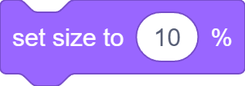


Set Turtle Up

Slide 8
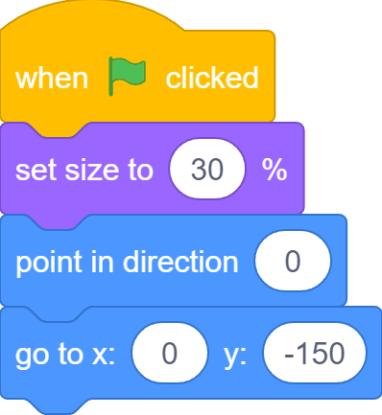
Set Turtle Up

Slide 9
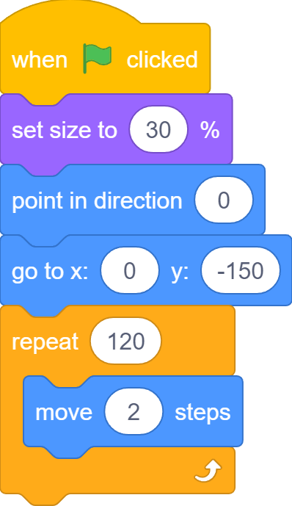
Move to Ocean

Slide 10
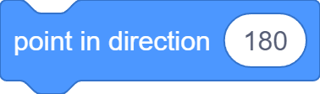
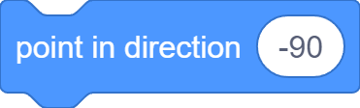
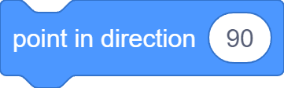
Change Turtle Direction

Slide 11

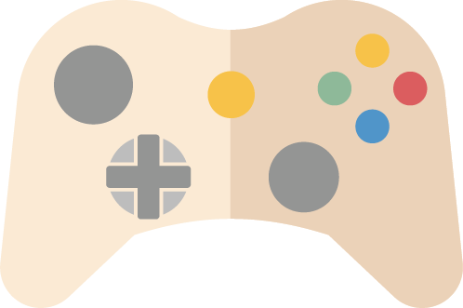

Game Controls

Slide 12




Control Turtle Direction

Slide 13
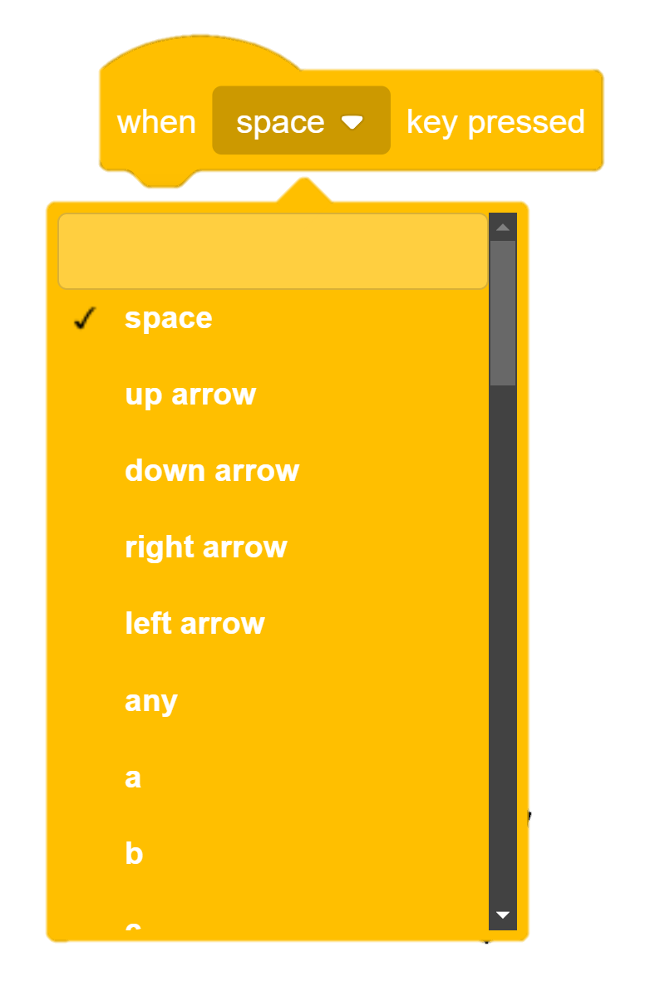
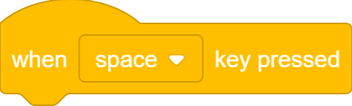
When Key Pressed…

Slide 14
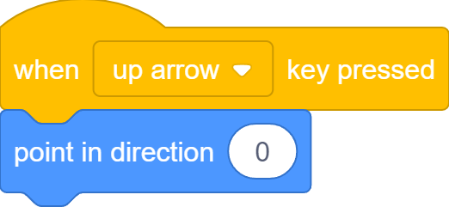
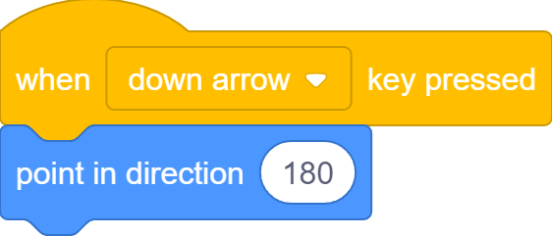

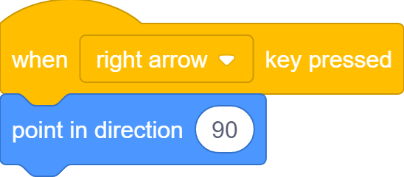
When Key Pressed…

Slide 15
Move to Ocean

Slide 16

Stop Somewhere
But sometimes, turtle stops before reaching the ocean…

Slide 17
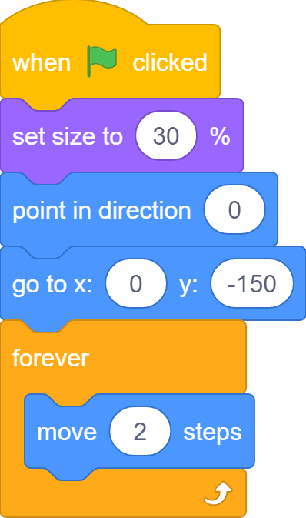
Move Forever

Slide 18
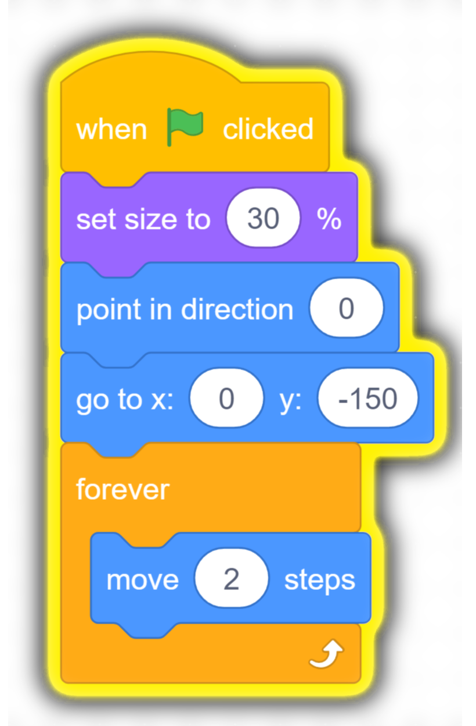
Move Forever
Turtle still moves after reaching ocean or hitting edge

Slide 19
Something In Between
We do not want to stop after moving some number of steps;
We do not want to move forever;
We want to stop after or move until reaching the ocean.

Slide 20
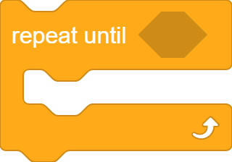
A third Type of Loop
It’s a loop
A hexagon slot for boolean blocks
Code blocks to repeat go inside

Slide 21











Boolean Blocks
Sensing
Operators

Slide 22
Boolean Blocks
Boolean blocks ask Yes or No questions. They are also called conditions that can be True (Yes) or False (No)

Slide 23


Boolean Blocks
Ture
False

Slide 24
Repeat Until…
If the condition is False, repeat
If the condition is True, jump out

Slide 25

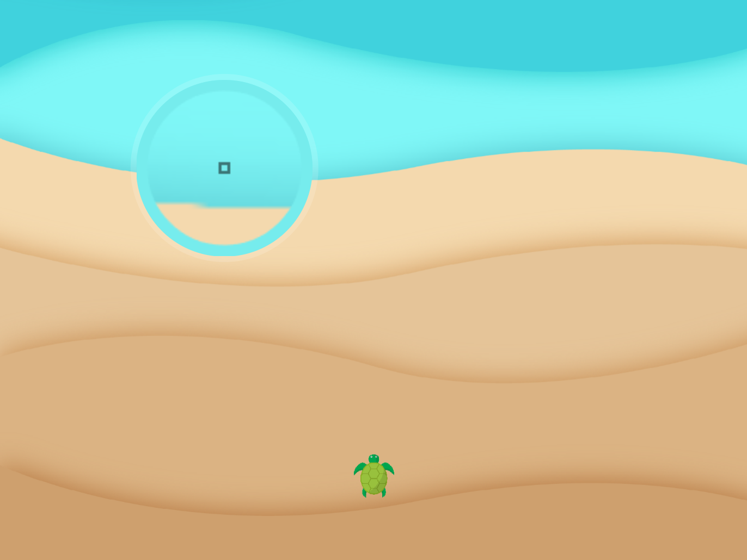
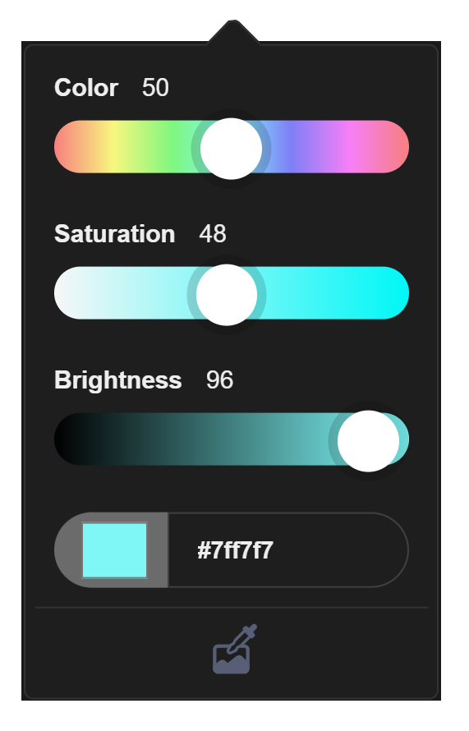
Reached Ocean?
Pick ocean color
Color Picker

Slide 26
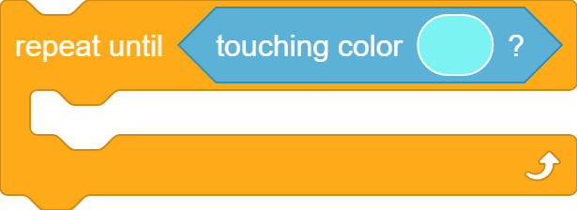
Repeat Until Reaching Ocean

Slide 27
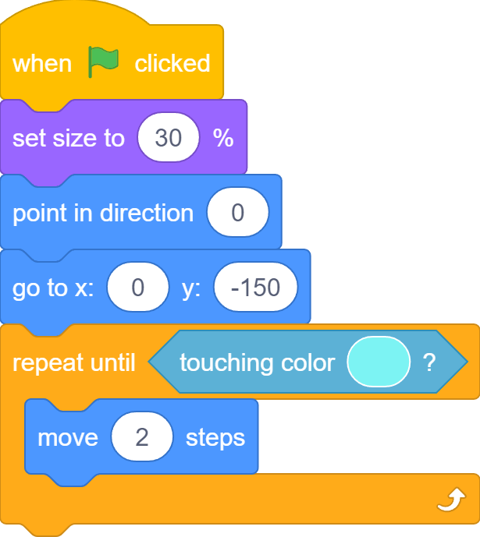
Repeat Until Reaching Ocean

Slide 28
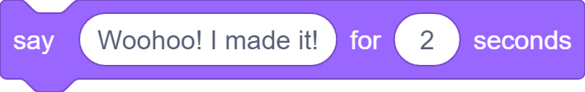
“Woohoo! I Made It!”

Slide 29
Pick a Local Crab
Scratch for Newbies
Level1
Lesson 6 – Turtle Crossing
Resources
Sprites
crab.png

Slide 30
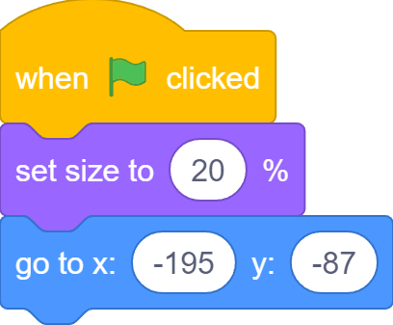
Set up Size and Position

Slide 31
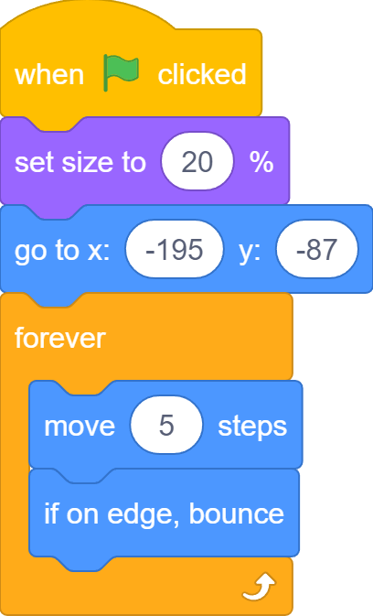
Move Sideway Forever

Slide 32

When Colliding…
Both turtle and crab continue to move after colliding…

Slide 33
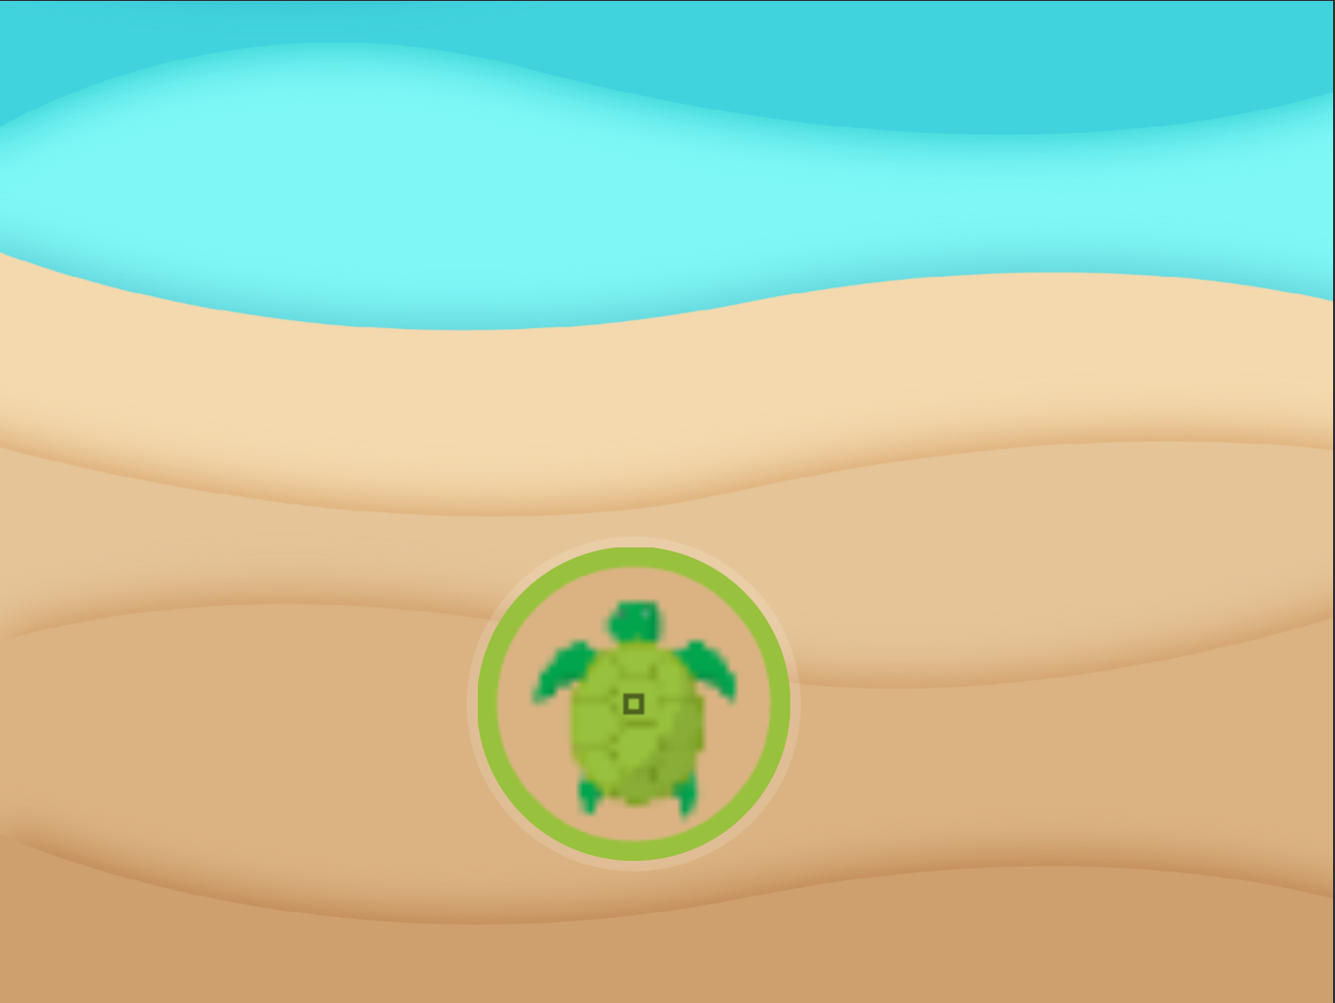

Is Crab Touching Turtle?

Slide 34
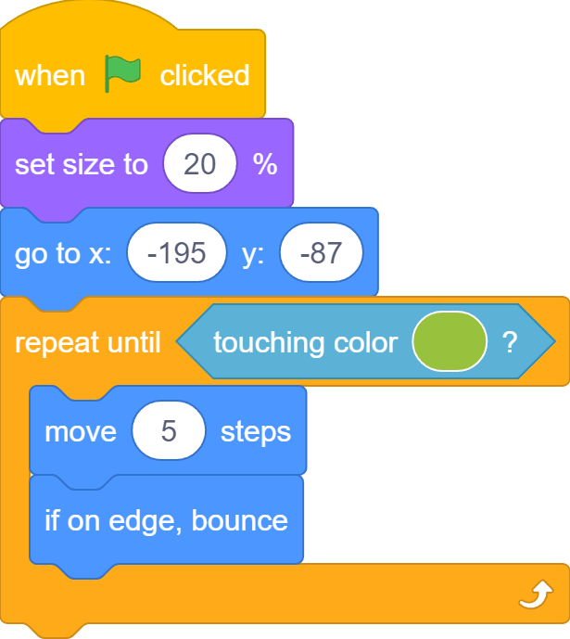
Stops When Touching Turtle

Slide 35
Stops When Touching Turtle
Crab stops moving as soon as it collides with the turtle

Slide 36
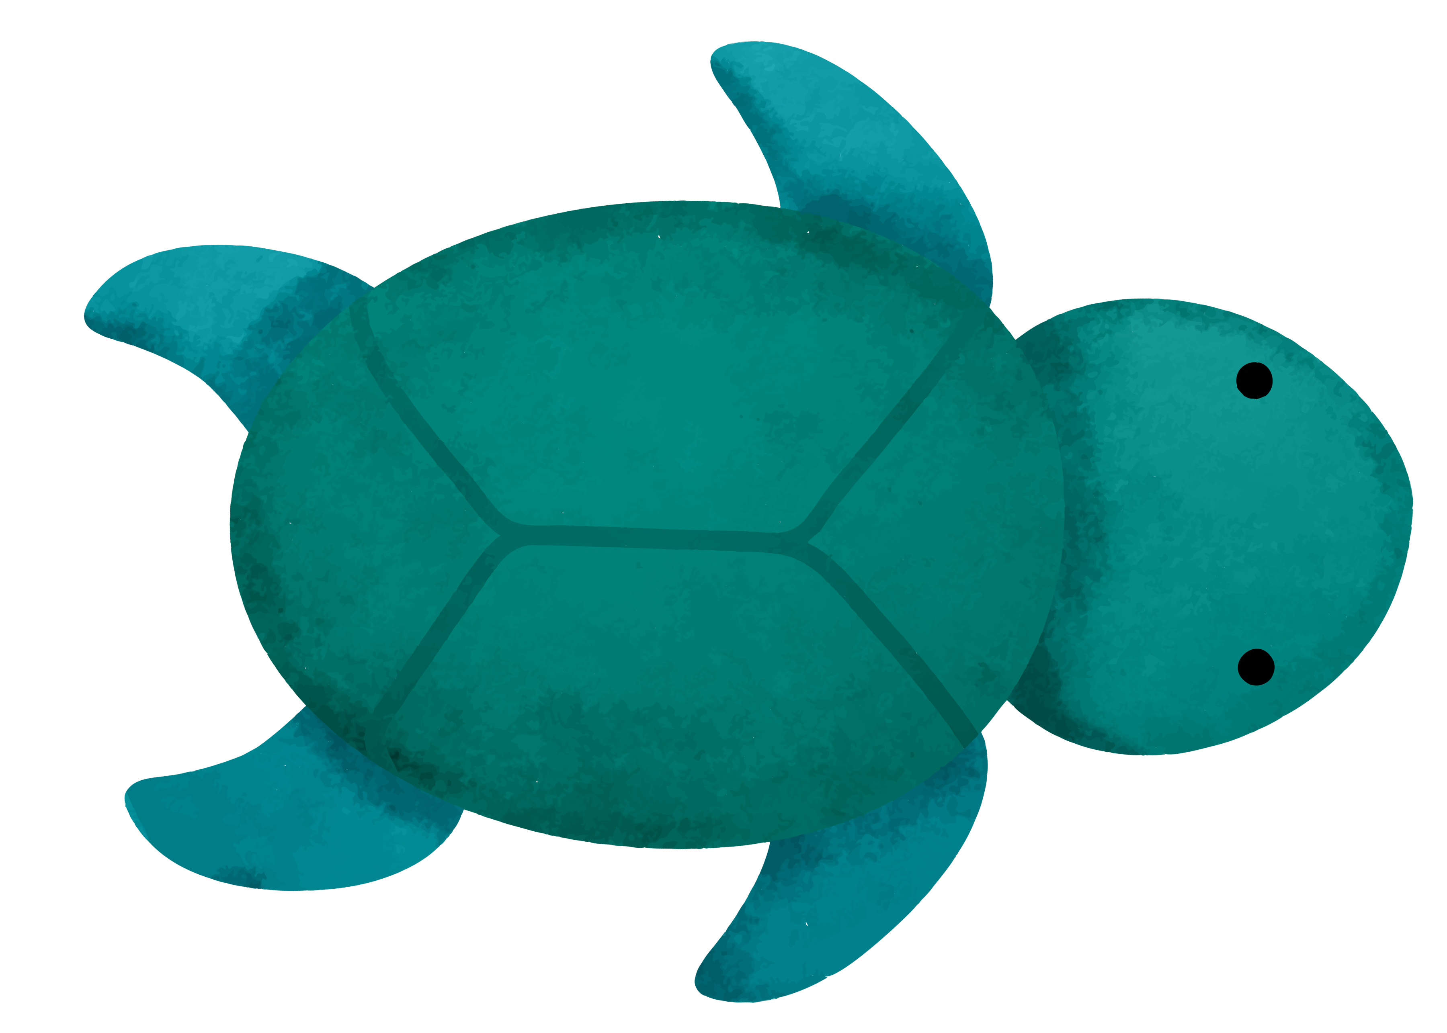
A New Turtle Costume

Slide 37
A New Turtle Costume
With a new costume, both turtle and crab continue to move again after colliding...

Slide 38
A New Turtle Costume
True
False

Slide 39
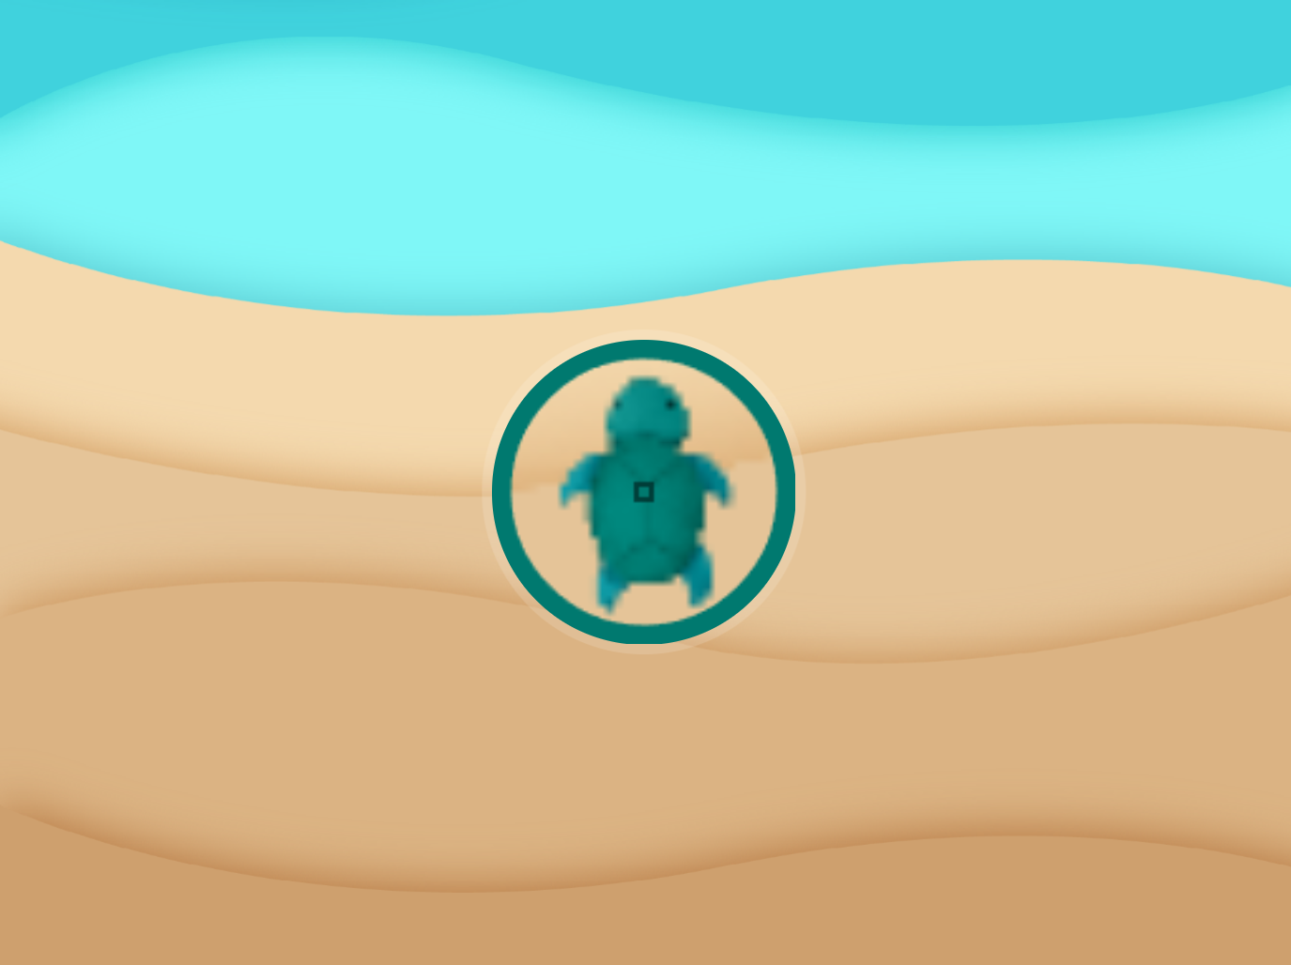

A New Turtle Costume

Slide 40
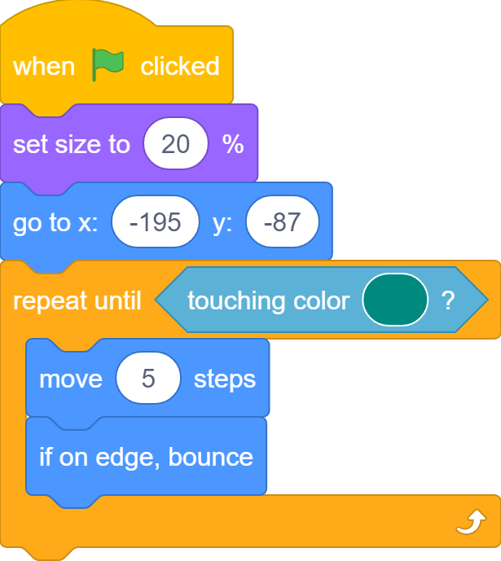
A New Turtle Costume

Slide 41
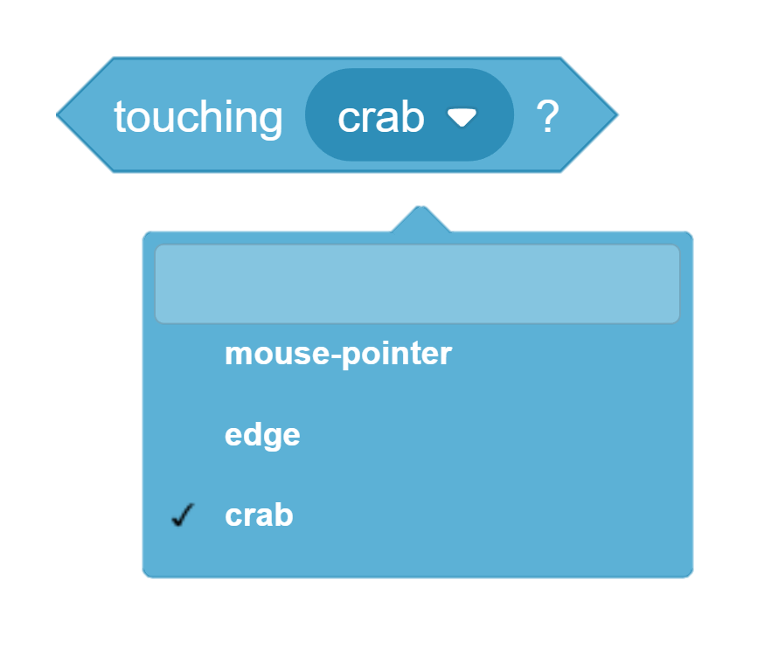
A Better Solution…

Slide 42
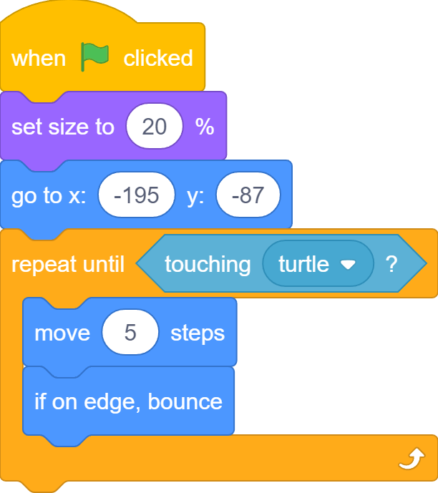
A Better Solution…

Slide 43
How to Stop Turtle?
Turtle continues to move after colliding with the crab…

Slide 44


We Can Stop Turtle
We can be the God and stop everything by clicking the STOP button, but…

Slide 45


The Game Should Stop Turtle
… the game should stop itself when it is game over!

Slide 46
The Crab is the God!
I know when I touch the turtle!

Slide 47

Stop All!
Stop all button, but We need to click it!
Stop all block, the Crab can do it!

Slide 48
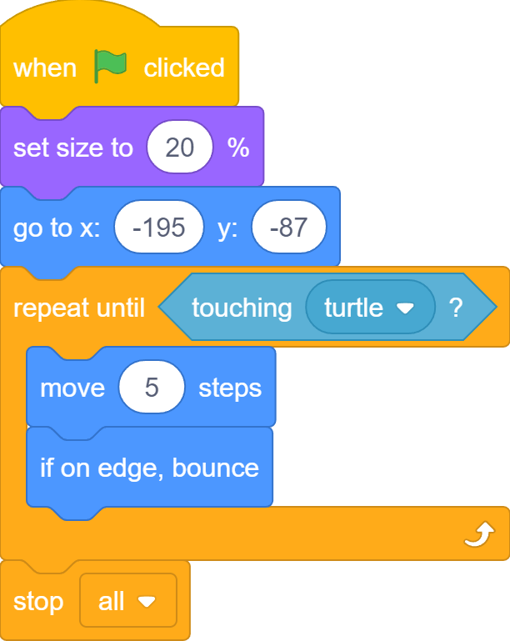
The Crab is the God!
I can stop the turtle and everything in the game!

Slide 49
How to Stop Turtle?
Nobody moves after a collision! Hooray!

Slide 50
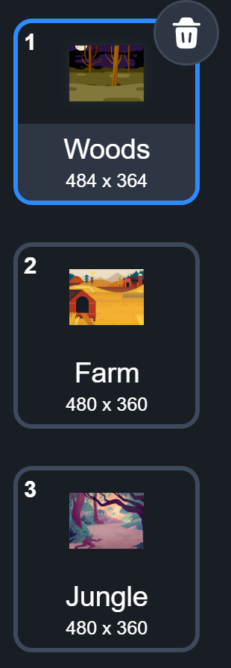
What we learnt…
How to create levels for games using backdrops

Slide 51
Exercises
Can you add even more distractions to the game?
Can you increase the amount of distraction as the players progress from level to level?
What else can you do to make it even harder to find the bug? (think about different effects you can apply to sprites)
Play the game with friends and families to see who is the best bug finder!

Slide 52
Thank you and see you in the next lesson!

